Slide 1
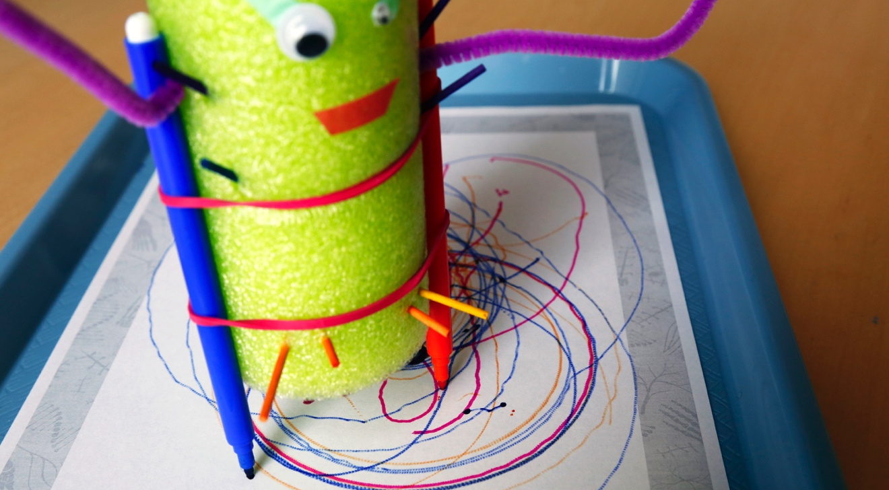
SCRIBBLE BOT
What happens when your creation comes to life?

Slide 2
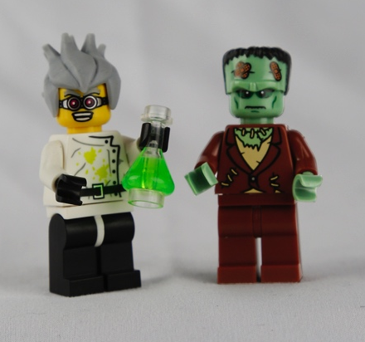
WHO WAS FRANKENSTEIN?
What do you know about Victor Frankenstein and his creature?
Victor Frankenstein and the “monster” he created first appeared 200 years ago in Mary Shelley’s novel Frankenstein. Since then, these characters have appeared in plays, movies, TV shows, comic books, and many other places.
You may recognize Frankenstein’s creature as a Halloween costume, a classic Hollywood monster, or the complex character in Shelley’s story.
Characters from Frankenstein inspired these LEGO® Minifigures. Victor Frankenstein is often portrayed as a “mad scientist” whose ambition leads him astray.

Slide 3
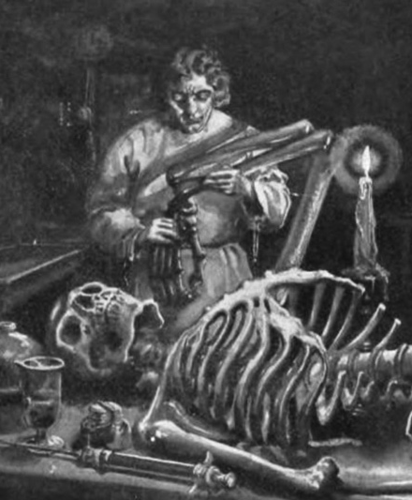
In Mary Shelley’s original story, Victor Frankenstein was a science student with a secret project. He built a person out of dead body parts and brought it to life.
When his creature began to move, Victor became scared of it. He thought his creature looked like a monster, and he let it run away.
In this activity, you will make a machine that seems to move on its own!
Victor Frankenstein used surgery, chemistry, electricity, and other methods to build his creature and bring it to life. This illustration is from an early edition of Mary Shelley’s 1818 novel.

Slide 4
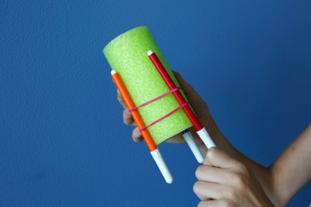
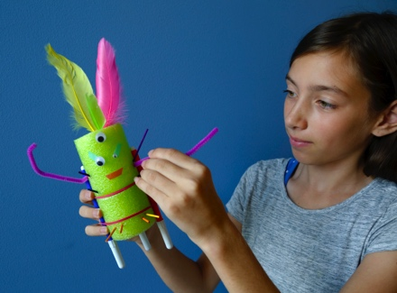
MAKE A CREATURE
1. Build the body.
Use rubber bands to attach three or four markers to the pool noodle. These will be your creature’s “legs.”
The drawing tips of the markers should point down and extend past the bottom of the tube.
2. Make it special.
Now make your creature unique. Decorate it and give it special features.
How can you give your creature its own personality and abilities?

Slide 5
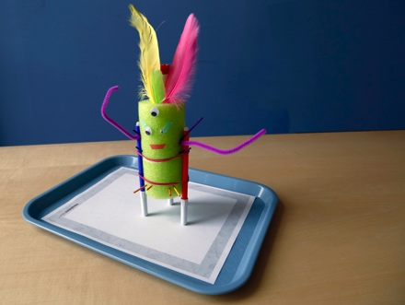
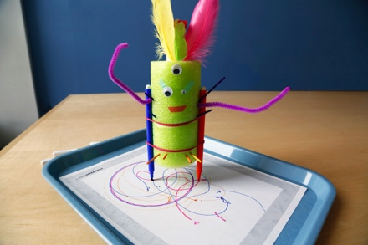
3. Bring it to life
Put an electric toothbrush inside the pool noodle.
Place a sheet of paper inside a tray. Uncap the markers and place your creature on the paper.
Now turn on the toothbrush. What happens?
When you’re done, take out the toothbrush and let someone else use it!
What can you change to make your scribble bot move differently?
Is your bot alive, or does it just seem to be?
Are its scribbles “art”? If so, who is the artist—you or your bot?

Slide 6
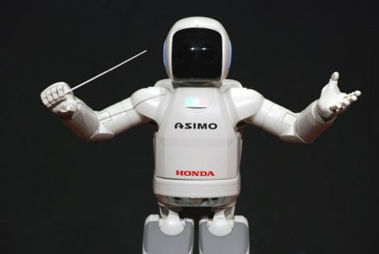
PEOPLE ARE CREATIVE
We’re always learning more about the world and inventing new things.
Some of our inventions can mimic life. Your scribble bot can move on its own and even make things, but it isn’t really alive the same way a plant or animal is. It can’t grow, reproduce, or adapt to its environment.
Researchers who study artificial intelligence make machines that can reason and learn over time. Like your scribble bot, some of these machines can make art. Robots that can make art blur the lines between people and machines.
Robots can appear almost human in their ability to sense, plan, and act. This robot can conduct an orchestra!

Slide 7
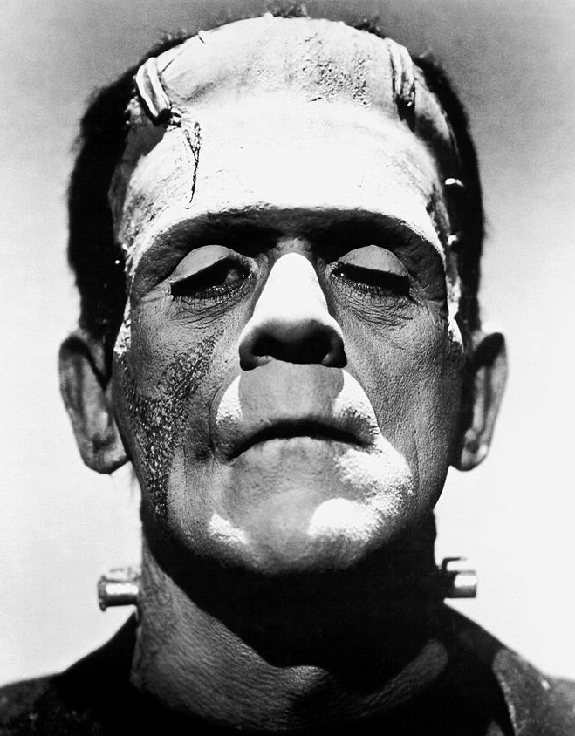
MONSTER OR MISTREATED?
Mary Shelley’s novel Frankenstein tells the story of a man who builds a creature and brings it to life—but doesn’t take responsibility for it.
Victor Frankenstein doesn’t think ahead to what care his creature will need, or what it might do. When his creature kills a child, Victor allows an innocent young woman to be convicted of the crime. He feels guilty and ashamed, but he doesn’t tell anyone he created the “monster.”
Do you think Victor Frankenstein is responsible for his creature’s actions?
What do you think Victor should have done when he realized the creature committed a crime?
Actor Boris Karloff tried to show the humanity of Frankenstein’s creature. Karloff played the character in many Hollywood movies.

Slide 8
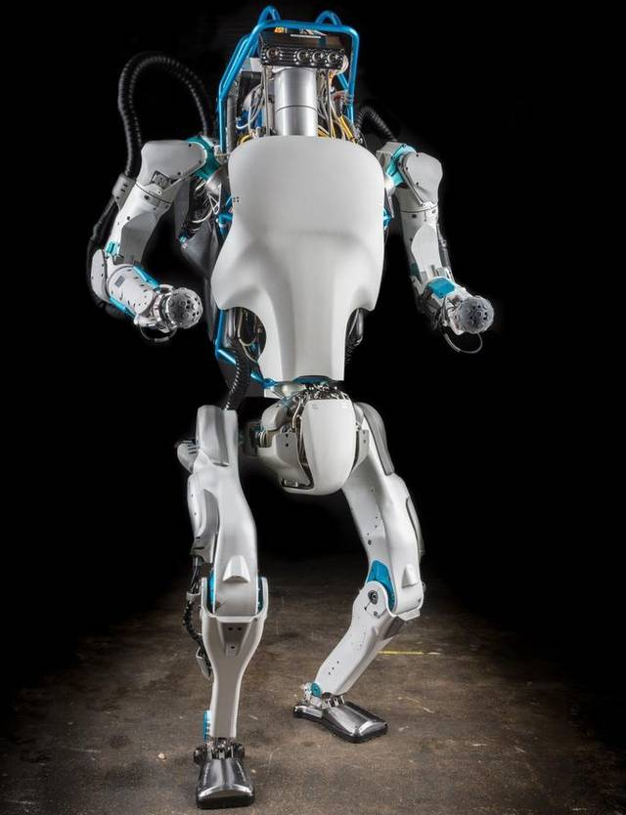
RESPONSIBLE INNOVATION
Is the inventor of a technology responsible for what it does?
Robots are often used for jobs that require precision, are repetitive, or are dangerous. Robots that look and act like people are called humanoid robots.
Many science fiction stories explore what might happen if machines became smarter than people. While this may never come to pass, we do need to consider how people can and will use technologies in different ways.
How do you think robots could change your life—and other people’s lives?
Do you think humanoid robots are friendly or creepy? Does it make a difference what they look like?
Robots are becoming more like humans. Some experts think that they could become a new species, Robo sapiens.

Slide 9




Mary Shelley’s novel Frankenstein is a 200-year-old science fiction story that explores themes of human creativity and scientific ethics. The Frankenstein200 project allows people across the United to States to exercise their creativity and consider responsible innovation in fields such as artificial intelligence and genetic engineering.
Frankenstein200 is a national project led by Arizona State University. In addition to hands-on activities, Frankenstein200 includes an alternate reality game that immerses players in a modern-day Laboratory for Innovation and Fantastic Explorations (L.I.F.E.). This fictional story imagines what might happen if a character named Dr. Tori Frankenstein picked up where her ancestor Victor Frankenstein left off.
Visit Frankenstein200.org to play the game!
Copyright 2017, Arizona State University. Published under a Creative Commons Attribution-Noncommercial-ShareAlike license: http://creativecommons.org/licenses/by-nc-sa/3.0/us/
Distributed in collaboration with the National Informal STEM Education Network: nisenet.org
This project was supported by the National Science Foundation under Grant Number 1516684. Any opinions, findings, conclusions, or recommendations expressed in this program are those of the authors and do not necessarily reflect the views of the Foundation.

