Slide 1
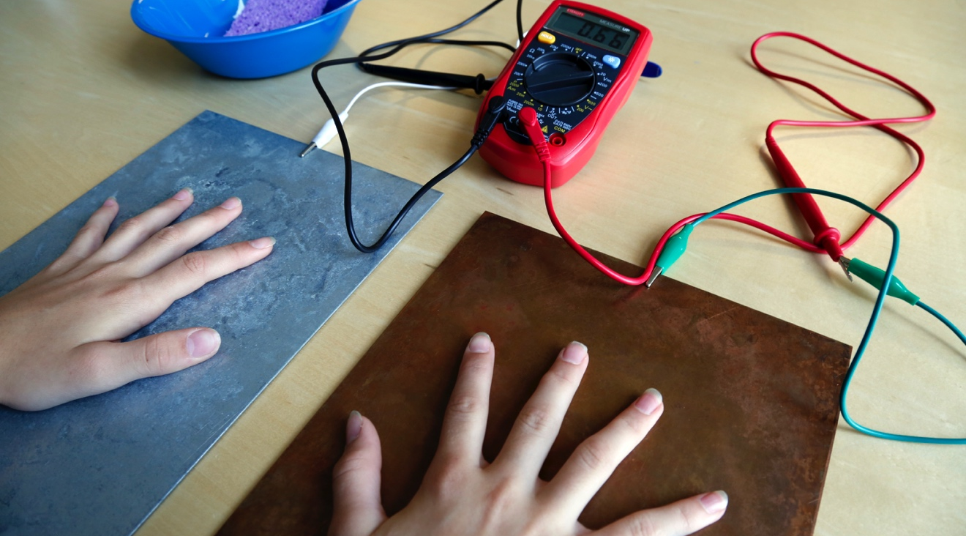
SPARK OF LIFE
How does your body react to electricity?

Slide 2
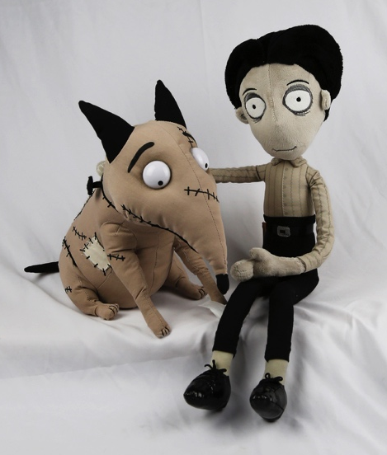
WHO WAS FRANKENSTEIN?
What do you know about Victor Frankenstein and his creature?
Victor Frankenstein and the “monster” he created first appeared 200 years ago in Mary Shelley’s novel Frankenstein. Since then, these characters have appeared in plays, movies, TV shows, comic books, and many other places.
You may recognize Frankenstein’s creature as a Halloween costume, a classic Hollywood monster, or the complex character in Shelley’s story.
Frankenweenie is a retelling of Mary Shelley’s story. The stop-motion animation film tells the story of a boy named Victor, who brings his dog Sparky back to life.

Slide 3
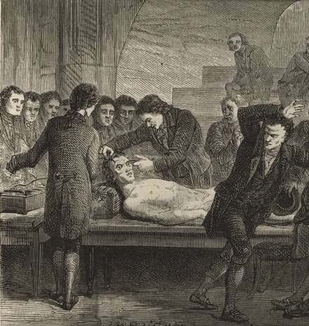
In Mary Shelley’s original story, Victor Frankenstein was a science student with a secret project. He built a person out of dead body parts and brought it to life.
Victor Frankenstein used surgery, chemistry, electricity, and other methods. In describing Victor’s research, Mary Shelley was inspired by scientific experiments taking place in England and Europe.
In this activity, you will see how the human body interacts with electricity!
During Mary Shelley’s time, people could watch experiments that applied electricity to dead bodies. This image shows a scientist shocking the corpse of a condemned criminal to see what would happen.

Slide 4
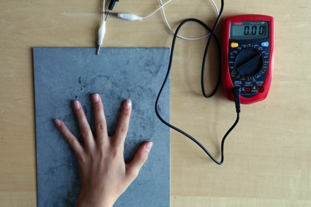
EXPLORE ELECTRICITY
1. Try one hand.
Place one hand on the steel sheet. Look at the meter, which measures electrical current. What does the meter say?

Slide 5
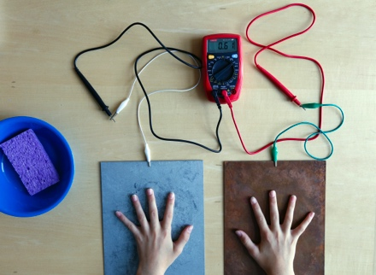
2. Try both hands.
Place your other hand on the copper sheet. Now what does the meter say?
Tip: If nothing happens, get your hands damp and try again.

Slide 6
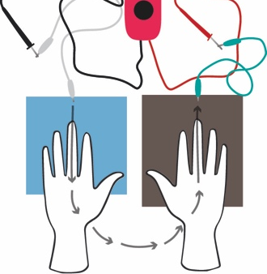
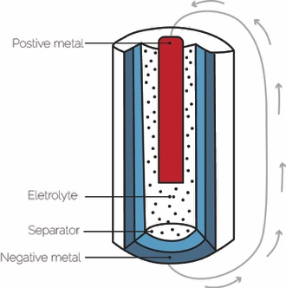
Your body conducts electricity!
The meter reading changes because your body can complete an electrical circuit! The thin lm of sweat on your hands creates a pathway for the charge to flow. The wire connecting the two metal plates allows the voltage to produce a current.
This is similar to the way most batteries work. Batteries are made of two different materials, one at the negative end and one at the positive end. They’re filled with an electrolyte solution.
It’s not just your hands that conduct electricity. Your entire body does! Salt water is a great conductor of electricity. (You’ve probably heard that your body is mostly water.) Your nerve cells use electrical signals to communicate throughout your body.
In a hand battery, electricity flows from the steel plate to the copper plate.
In a modern battery, electrons flow from the negative terminal to the positive terminal.

Slide 7
Electrical current stimulates nerves and muscles!
Some medical technologies use electricity. For example, the low-voltage electrical current produced by a TENS unit may relieve pain or help people recover from injuries. TENS stands for transcutaneous electrical nerve stimulation.
The batteries in the TENS machine create an electrical current that travels through the electrodes and into the body. The electricity stimulates the nerves in the body, which can cause muscles to contract in strange ways.
Would you try a TENS unit to help heal an injury? Would you be nervous or excited to see if it worked?
In a hand battery, electricity flows from the steel plate to the copper plate.
In a modern battery, electrons flow from the negative terminal to the positive terminal.

Slide 8
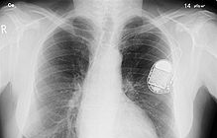
PEOPLE ARE CREATIVE
We’re always learning more about the world and inventing new things.
In the field of medicine, new technologies can improve people’s health or save their lives.
For example, artificial cardiac pacemakers use electrical impulses to keep the heart beating at regular intervals. Patients had to wear early pacemakers outside their bodies, but as battery technologies improved, doctors could insert pacemakers inside the body.
The engineer Earl Bakken created the first wearable external pacemaker. He was inspired at a young age by the novel Frankenstein.
An X-ray image shows a pacemaker inside the body. This medical device uses electricity to keep the heart beating regularly.

Slide 9
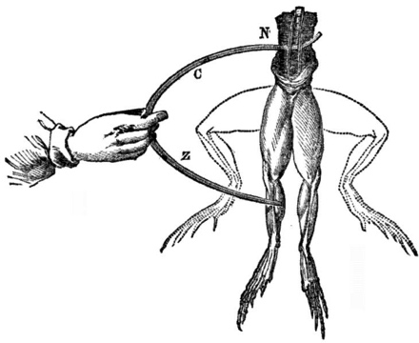
FRANKENSTEIN & ELECTRICITY
Mary Shelley’s novel Frankenstein was inspired by early scientists who studied electricity.
In 1803, a famous experiment took place in London, using the body of a hanged man. A scientist took a pair of conducting rods that were connected to a powerful battery and applied them to the dead man’s body. The electrical current made the corpse’s body move, and one eye opened!
In Shelley’s novel, Victor Frankenstein says, “By the glimmer of the half-extinguished light, I saw the dull yellow eye of the creature open; it breathed hard, and a convulsive motion agitated its limbs.”
How do you think Shelley may have felt about the electrical experiments going on during her lifetime?
How would you have felt about them?
Luigi Galvani discovered that a frog’s leg would twitch in response to an electrical spark. Mary Shelley thought “Galvanism” showed that it might be possible to bring a dead body back to life.

Slide 10
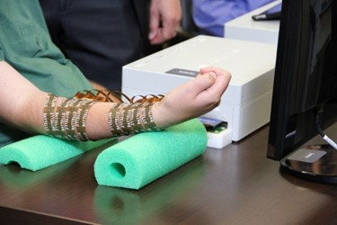
RESPONSIBLE INNOVATION
Frankenstein suggests that as we study science and make new technologies, it’s important to think ahead.
People can use technologies to treat illness or overcome disability. They can also use technologies to improve the body’s performance.
Today, some people take medications to help them concentrate. In the future, they might consider neural implants to improve their memory.
Would you get a chip in your brain to help you move a paralyzed arm?
Would you get a brain chip to become better at sports?
Technology can help paralyzed people regain use of their limbs. Brain implants can allow the brain to communicate directly with a patient’s arm and hand, bypassing the injured spinal cord.

Slide 12




Mary Shelley’s novel Frankenstein is a 200-year-old science fiction story that explores themes of human creativity and scientific ethics. The Frankenstein200 project allows people across the United to States to exercise their creativity and consider responsible innovation in fields such as artificial intelligence and genetic engineering.
Frankenstein200 is a national project led by Arizona State University. In addition to hands-on activities, Frankenstein200 includes an alternate reality game that immerses players in a modern-day Laboratory for Innovation and Fantastic Explorations (L.I.F.E.). This fictional story imagines what might happen if a character named Dr. Tori Frankenstein picked up where her ancestor Victor Frankenstein left off.
Visit Frankenstein200.org to play the game!
Copyright 2017, Arizona State University. Published under a Creative Commons Attribution-Noncommercial-ShareAlike license: http://creativecommons.org/licenses/by-nc-sa/3.0/us/
Distributed in collaboration with the National Informal STEM Education Network: nisenet.org
This project was supported by the National Science Foundation under Grant Number 1516684. Any opinions, findings, conclusions, or recommendations expressed in this program are those of the authors and do not necessarily reflect the views of the Foundation.

